Slide 1

LINKED LIST
BY-ANUJRAJ MOHAPATRA

Slide 2
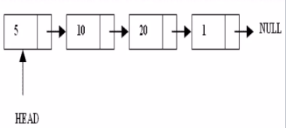
WHAT ARE LINKED LISTS
A linked list is a linear data structure.
Nodes make up linked lists.
Nodes are structures made up of data and a pointer to another node.
Usually the pointer is called next.

Slide 3
TYPES OF LISTS
There are two basic types of linked list
Singly linked list
Doubly linked list
Singly linked list:
Each node has only one link part
Each link part contains the address of the next node in the list
Link part of the last node contains NULL value which signifies the end of the node

Slide 4

SCHEMATIC REPRESENTATION
Here is a Singly-linked list (SLL):
Each node contains a value (data) and a pointer to the next node in the list
myList is the header pointer which points at the first node in the list

Slide 5
BASIC OPERATIONS ON A LIST
Creating a list
Inserting an element in a list
Deleting an element from a list
Searching a list
Reversing a list

Slide 6
CREATE
How to create a linked list?
The first step of creating linked list of n nodes starts from defining node structure. We need a custom type to store our data and location of next linked node. Let us define our custom node structure
struct node {
int data;
struct node *next;
};
where data is the data you want to store in list. *next is pointer to the same structure type. The *next will store location of the next node if exists otherwise NULL.

